Slide 1
Data analysis for Forbes billionaire
Group 4

Slide 2

The source of wealth for richest men around the globe

Slide 3
Introduction
During this presentation, we will explore the latest rankings, trends, and insights from the Forbes Rich List. We will examine the individuals who have secured their positions on this prestigious list, learn about the industries that have driven their success, and gain a deeper understanding of the factors that contribute to wealth accumulation in today's fast-paced world.

Slide 4
Main focus
age
country
Net worth
source
industries

Slide 5
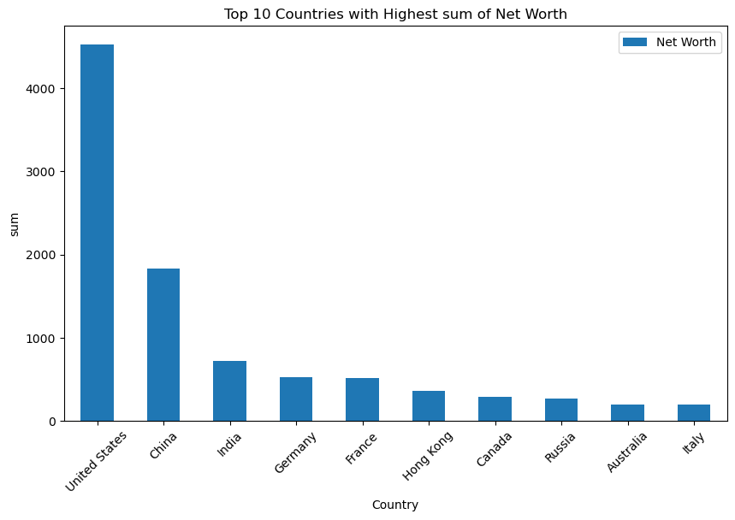
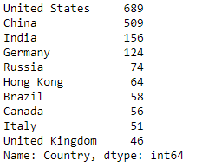
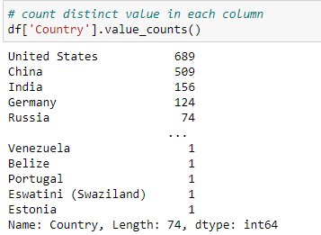

Slide 6
Country
Through our findings we were able to determine that geographically the United States of America has ranked the highest of the top ten with a combined net worth of $4521,90B

Slide 7
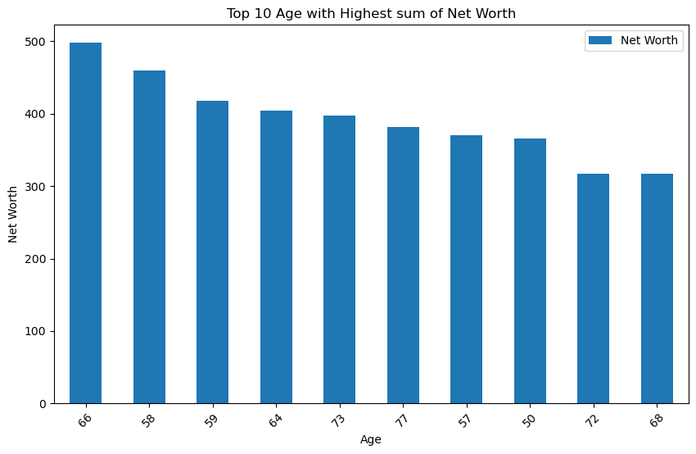

Slide 8
age
When analyzing the Forbes wealthiest individuals list, it's evident that a significant portion of the wealthiest people fall within the age range of 60 to 80 years old. This age group is often associated with decades of experience, business acumen, and accumulated wealth.

Slide 9
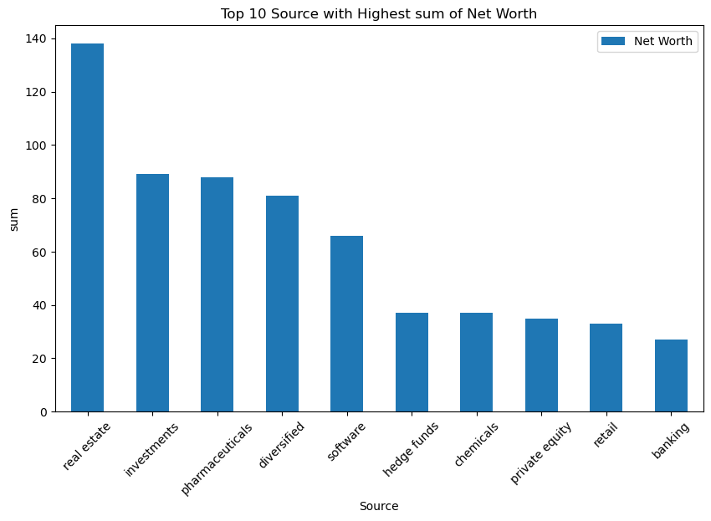
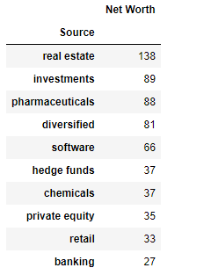

Slide 10
sources
From our analysis, out of the top 10 sources of wealth 138 individuals accumulated their wealth through real estate, making the real estate the highest wealth generating source.

Slide 11
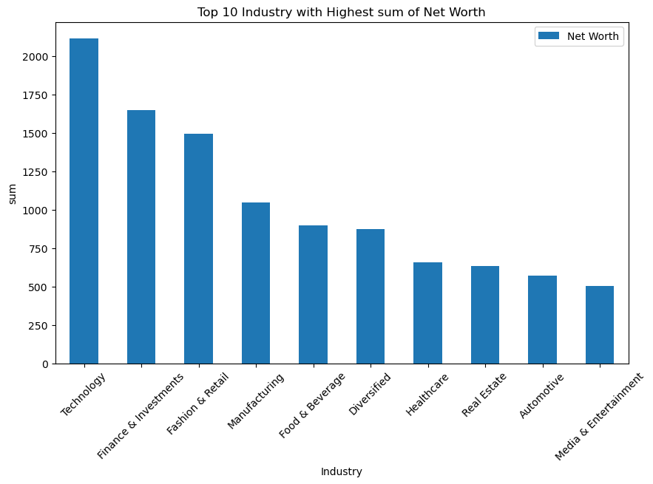
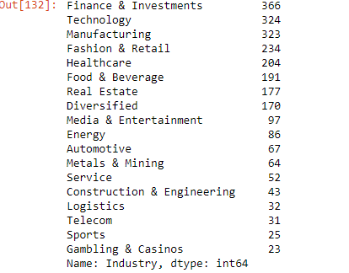

Slide 12
CONCLUSION
From our findings the richest men invested in technology as industry and are from the united States of America which can be attributed to the country’s good economy
most of these wealthiest men can be classified as pensioners as per their age average.
We can appreciate that wealth accumulation can be a lifetime journey that require years of experience and knowledge.

